Slide 1
Operators
Created by: Rahul Majukar

Slide 2
Operators in Java
Operator in java is a symbol that is used to perform operations. For example: +, -, *, / etc.
There are many types of operators in Java which are given below:
Unary Operator,
Arithmetic Operator,
Shift Operator,
Relational Operator,
Bitwise Operator,
Logical Operator,
Ternary Operator and
Assignment Operator.

Slide 3
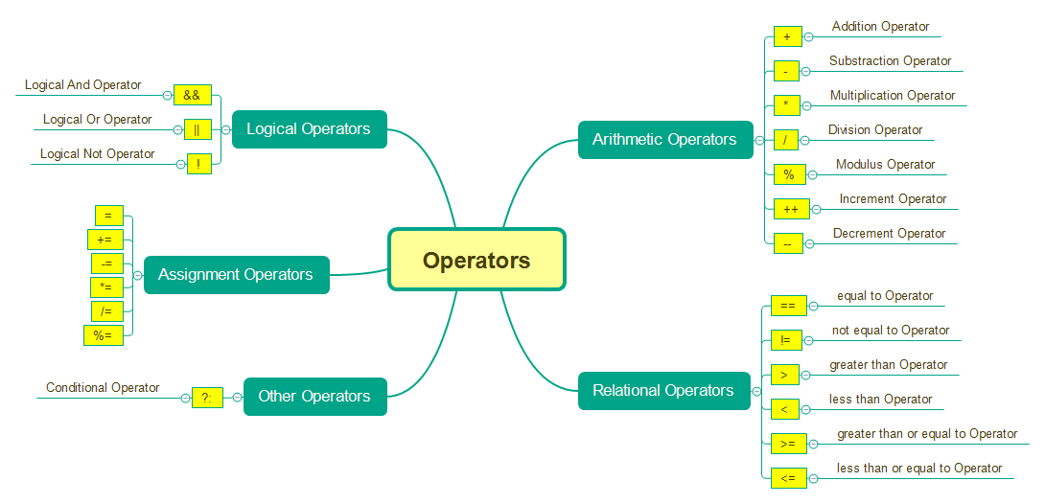
Operators in Java

Slide 4
Unary Operator
The Java unary operators require only one operand. Unary operators are used to perform various operations i.e.:
incrementing/decrementing a value by one
negating an expression
inverting the value of a boolean
Example:
int x=10;
System.out.println(x++);//10 (11)
System.out.println(++x);//12
System.out.println(x--);//12 (11)
System.out.println(--x);//10
Example2: Unary Operator addition
int a=10;
int b=10;
System.out.println(a++ + ++a);//10+12=22
System.out.println(b++ + b++);//10+11=21

Slide 5
Arithmetic operators
operators are used to perform addition, subtraction, multiplication, and division.
10*10/5+3-1*4/2 = 21
Example:
int a=10;
int b=5;
System.out.println(a+b);//15
System.out.println(a-b);//5
System.out.println(a*b);//50
System.out.println(a/b);//2
System.out.println(a%b);//0

Slide 6
Assignment Operators
It is used to assign the value on its right to the operand on its left.
Example 1: | Example 2:
int a=10; int b=20; a+=4;//a=a+4 (a=10+4) b-=4;//b=b-4 (b=20-4) System.out.println(a); System.out.println(b); | int a=10; a+=3;//10+3 System.out.println(a); a-=4;//13-4 System.out.println(a); a*=2;//9*2 System.out.println(a); a/=2;//18/2 System.out.println(a);

Slide 7
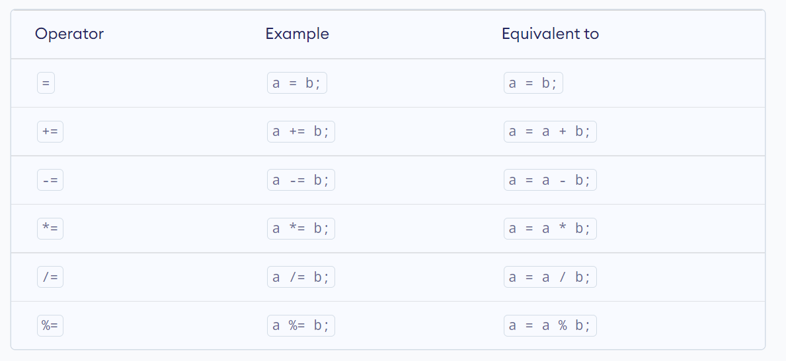
Assignment Operators

Slide 8
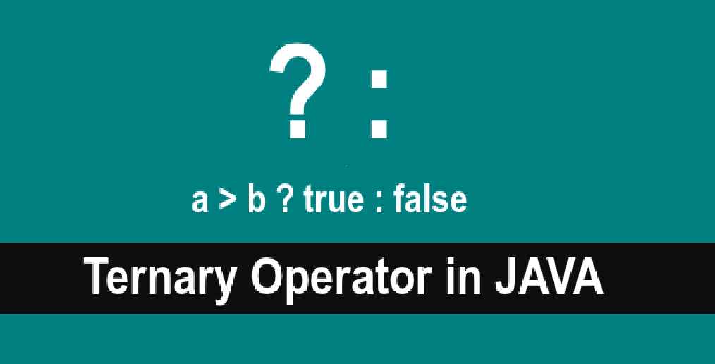
Java Ternary Operator
Java Ternary operator is used as one line replacement for if-then-else statement
Example:
int a=2;
int b=5;
int min=(a<b)?a:b;
System.out.println(min);

Slide 9
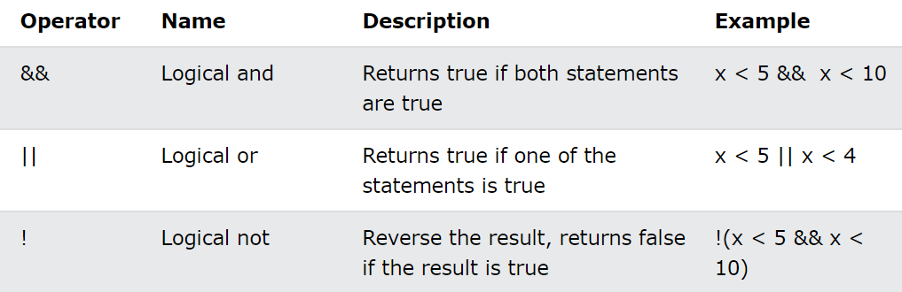
Java Logical Operators
Logical operators are used to determine the logic between variables or values

Slide 10
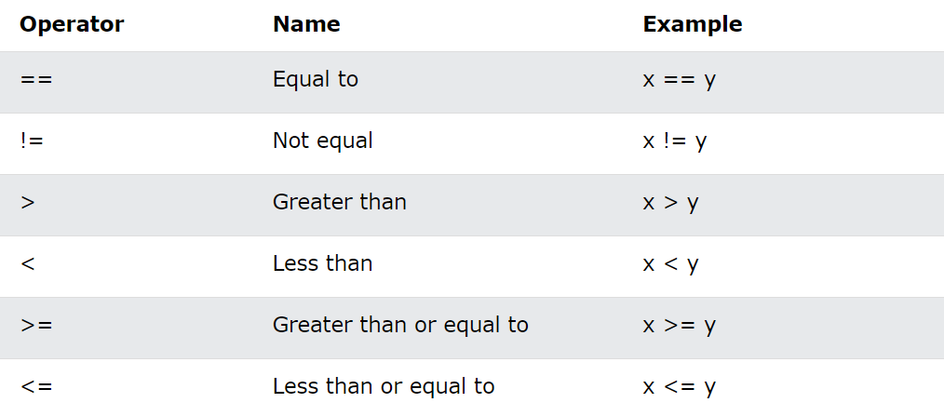
Comparison Operators or Relational operators
Comparison operators are used to compare two values

